Slide 1
Typed HTML5 Evaluation Machine (THEM)
Client: Lorna MacDonald (DECO1400 Course Co-ordinator)
Members: Carl Hattenfels, Scott Heiner, Shen Yong Lau, Robert Meyer, Brendan Miller, David Uebergang

Slide 2
Typed HTML5 Evaluation Machine (THEM)
The Problem
The Solution
Pressure on DECO1400 to move towards new web standards
HTML5 is forgiving
Difficult to evaluate whether HTML5 meets “best practice” criteria
Few applications exist currently to evaluate HTML5
Web based application
PHP / Python interaction
Direct Upload
File Upload (in singular and multiple)
Complete website upload

Slide 3
Work Breakdown and Supplementary Costs
Initial Set Up – 40 hours
Implementation (Front End) – 60 hours
Implementation (Back End) – 218 hours
User Testing – 106 hours
Functional Testing – 132 hours
Documentation – 90 hours
Marketing – 16 hours
Total: 662 hours
Work Costs: $50 for project manager, $35 for other team members
Supplementary Costs: Server Hosting $10/month
Total Cost: $24 820 (plus ongoing costs)

Slide 4
Risk Analysis
Other course workload
Distributing jobs between at least 2 team members
Possible knowledge gap between users and our team
Continuous user testing
Lack of previous examples
Anonymous examples provided by client, as well as personal examples we create, and continuous user testing
Too many ideas / Conflict of ideas
Voting system in place to determine the best possible idea

Slide 5
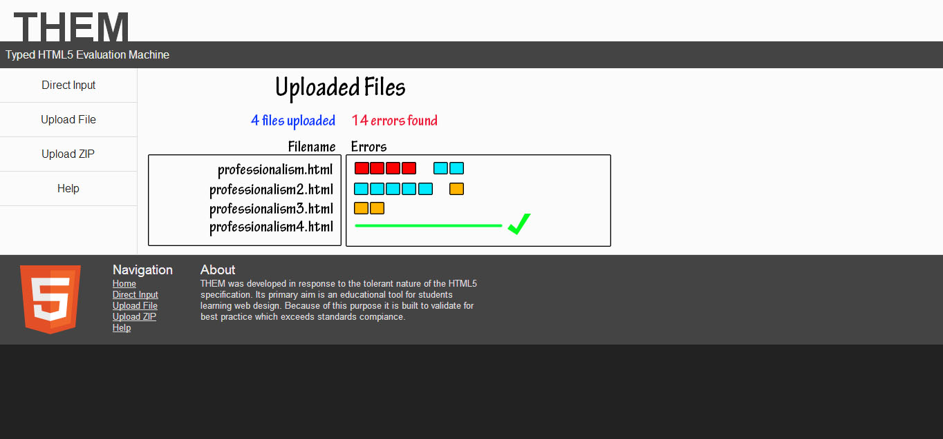
Prototype
http://underwaterfall.com/

